Slide 1
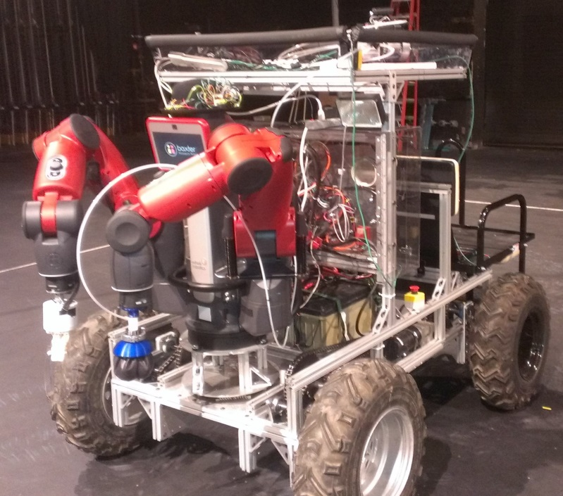



Robotic Assist Vehicle for Extraterrestrial Navigation
RAVEN
Researcher: Matthew Plank
Mentor: Srikanth Saripalli
Arizona State University

Slide 2
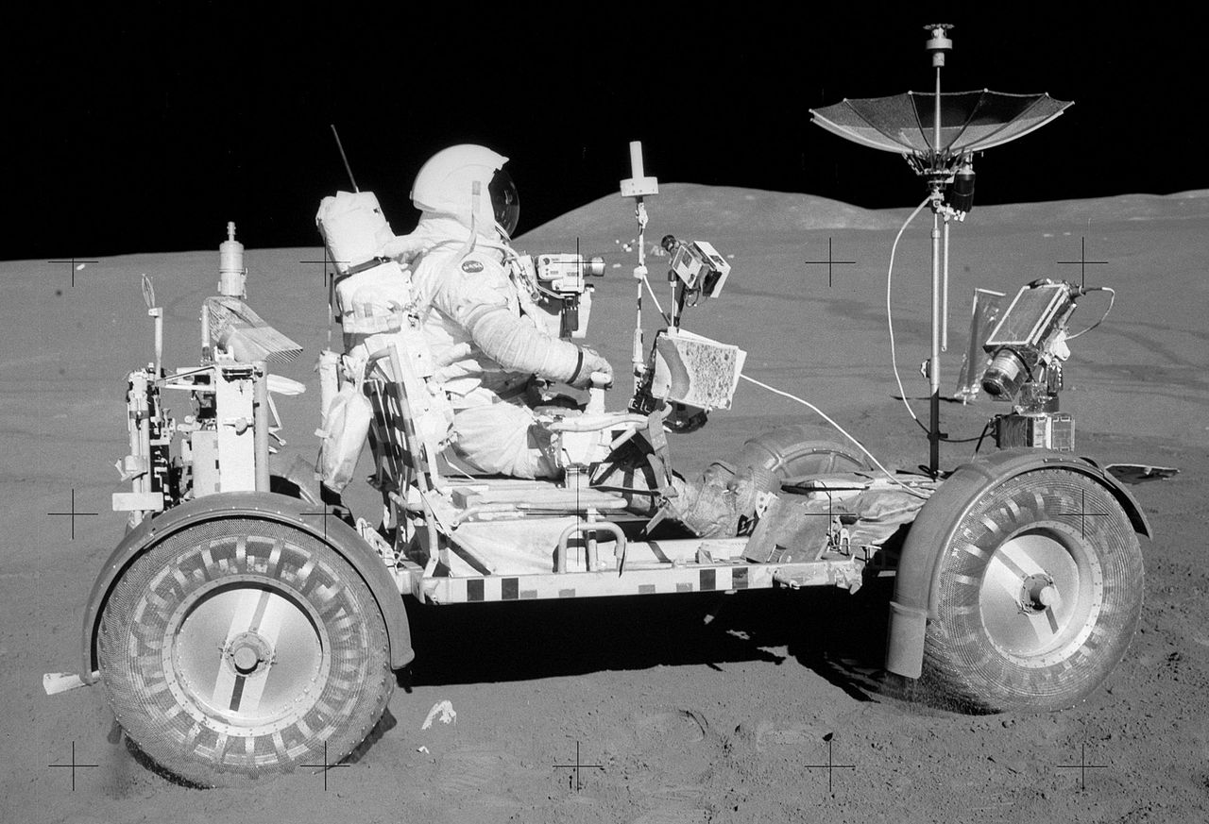
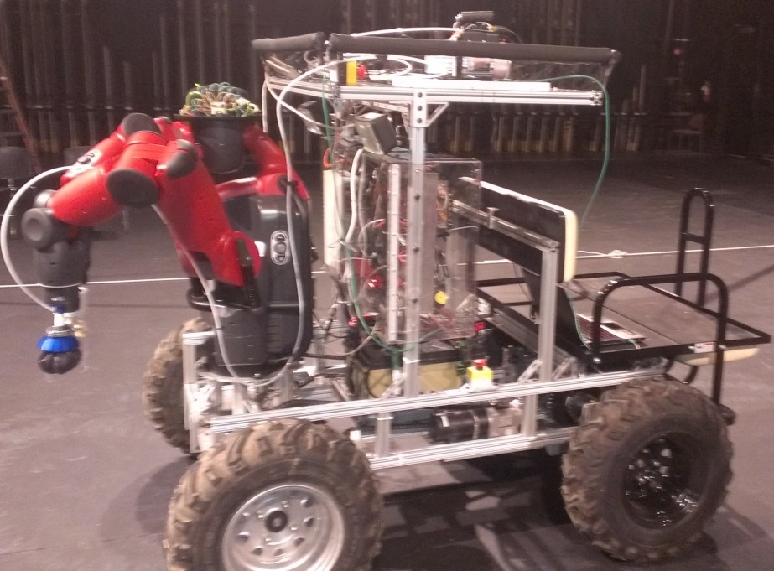
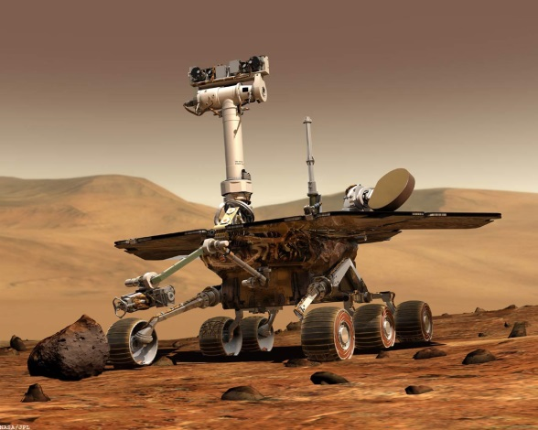
PROJECT DESRIPTION: Raven is a test platform for a support vehicle that can be both autonomous and remotely operated by space travelers for planetary exploration.
Hybrid of the Lunar Rover (Moon Buggy) and extraterrestrial ROV’s such as Opportunity and Curiosity
=
+
Notes:
FUNCTIONALITY: Raven can accomplish a variety of tasks such as transporting astronauts and/or equipment, surveying, or collecting samples. Raven is equipped with an industry automation robot named Baxter, it has two arms that allow it to pick up and manipulate objects. Raven’s helipad holds a quadcopter that can scout the terrain ahead and cover more ground to survey around a point of interest. The quadcopter will be able to complete it’s missions either autonomously or remotely controlled. Raven can be be fitted with a variety of sensors for surveying and scouting.

Slide 3
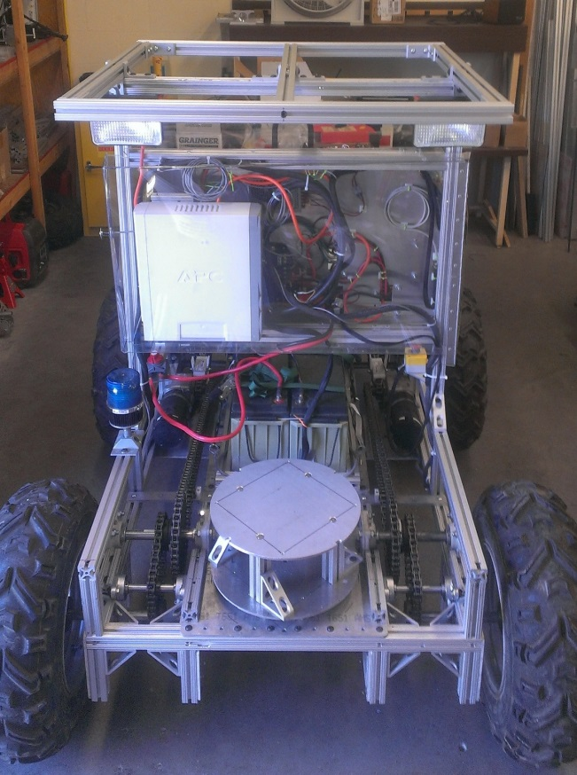
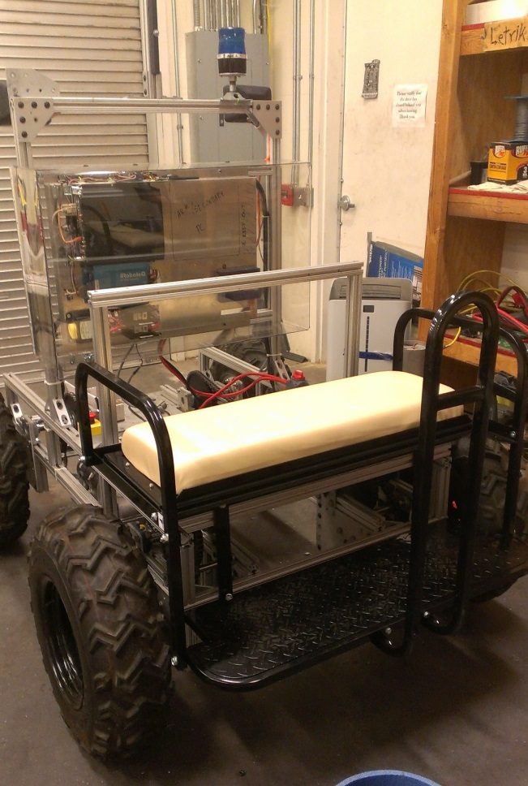
RAVEN Feature Overview
FRONT
REAR
Microcontroller, Receiver, GPS & Compass
Helipad
Headlights
Electronics Enclosure w/ Sliding Tray
Batteries
Computer
High Torque DC Motors
Motor Controller
80/20 Aluminum Frame
Baxter Mounting Plate
Chain Drive Skid Steer
Seat / Utility Tray & Step
ATV Tires
Notes:
FEATURES: Raven is currently controlled by an ArduPilot microcontroller and an RC radio system. It features a GPS, compass, 900Mhz transmitter/receiver for navigation. There is an onboard computer and power inverter to operate and run Baxter. A RobotiQ Motor Controller controls 2 high torque DC motors. Raven runs off a chain drive system with uses a tank drive or skid steer type system. All of this is powered from 2 high capacity 12V lead acid run in series for a total of 24V. The frame is constructed of 1.5” 80/20 aluminum framing for both strength and lower weight. Located in the rear is a golf cart seat for transporting people which doubles as a fold down tray to accommodate tools, samples, or other items.

Slide 4
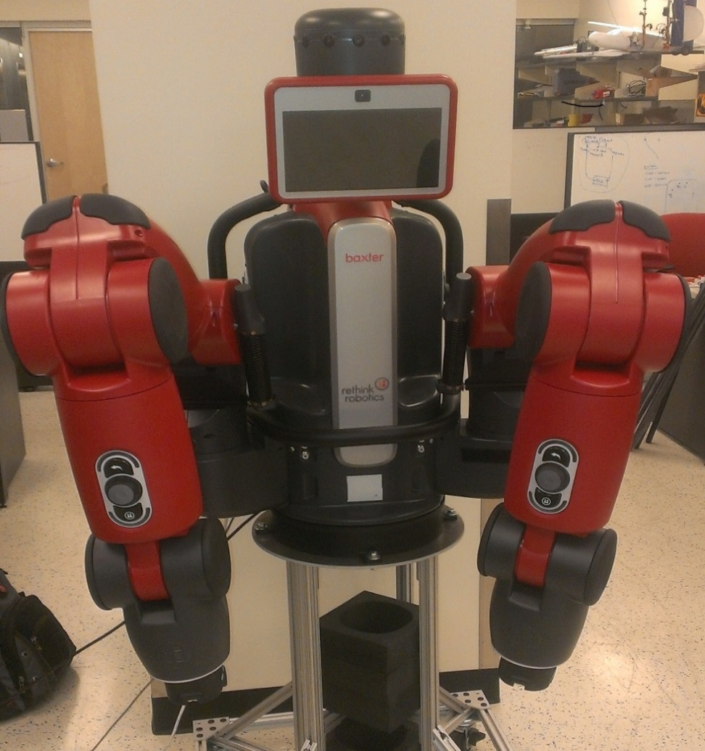
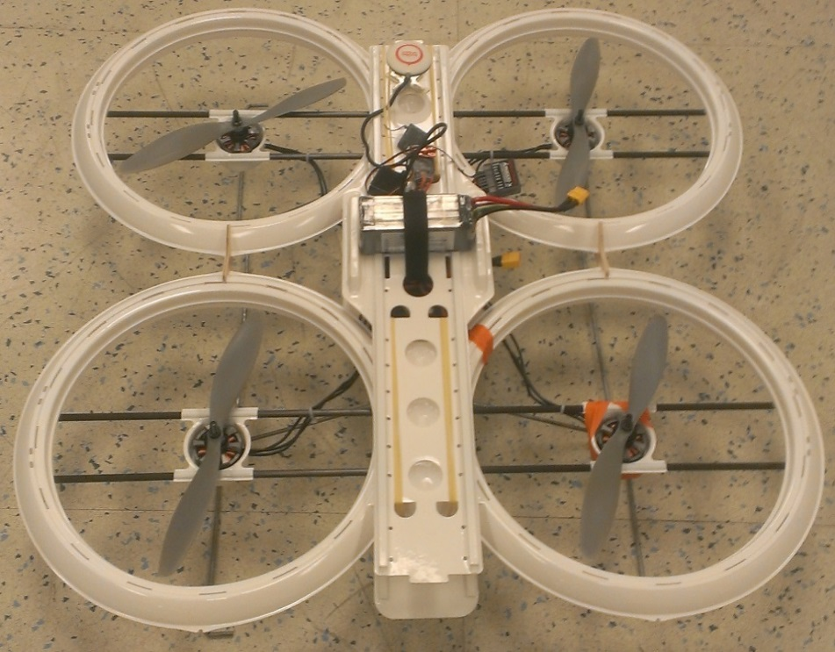
Additional Features
Quadcopter
Baxter
(Industrial Automation Robot)
Notes:
BAXTER & QUADCOPTER: Baxter will be used to pick up and collect items when Raven is being driven remotely from a home base or when something may be hazardous for the astronaut to handle. The quadcopter or another UAV (unmanned aerial vehicle) can be launched from Raven’s helipad which further allow explorers to extend the range of their search and investigation capabilities.

Slide 5
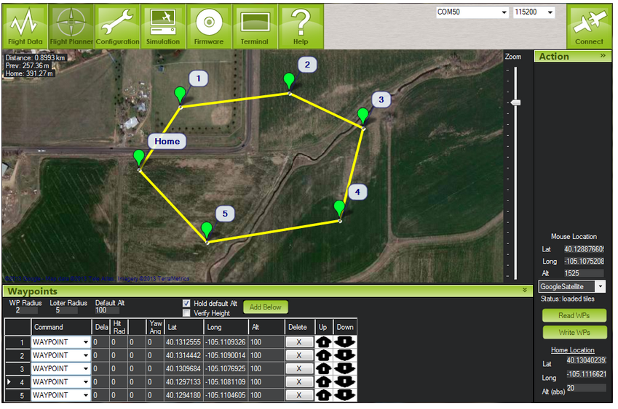
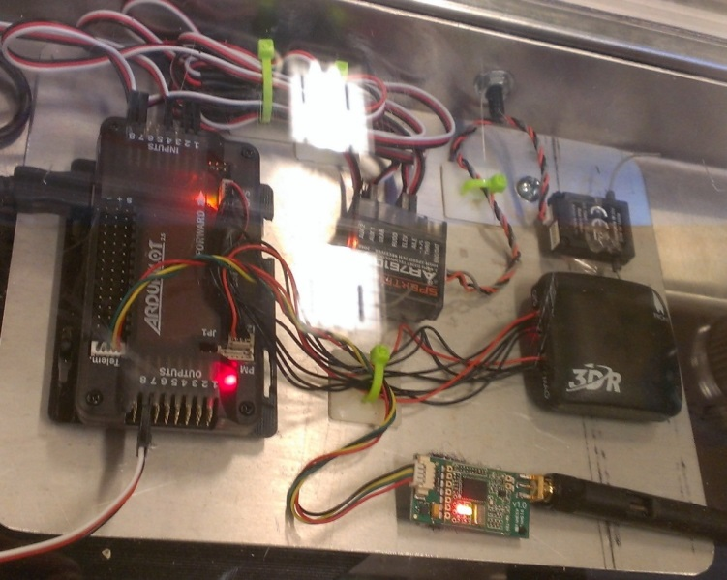
Autonomous Waypoint Navigation
Microcontroller, Receiver, GPS & Compass
ArduPilot Navigation Software

Slide 6
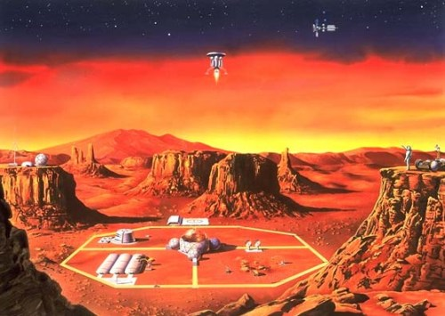
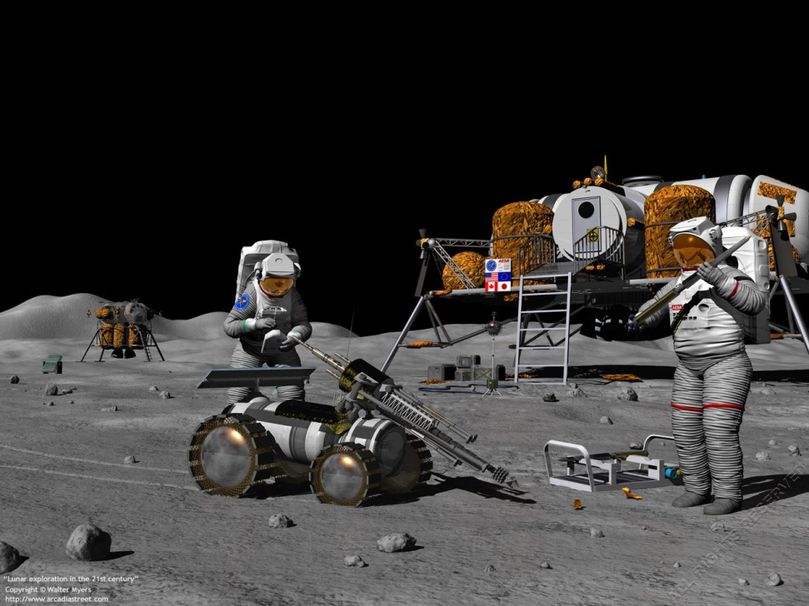
Conclusion: The Future
Notes:
Conclusion: As space travel becomes privatized and more widely available, there is a great need for robotic systems to assist mankind to explore, colonize, and search for resources on other planets. Projects like Raven turn that into a reality and make it both efficient and affordable to those willing to boldly go where no one has gone before.

